Slide 1
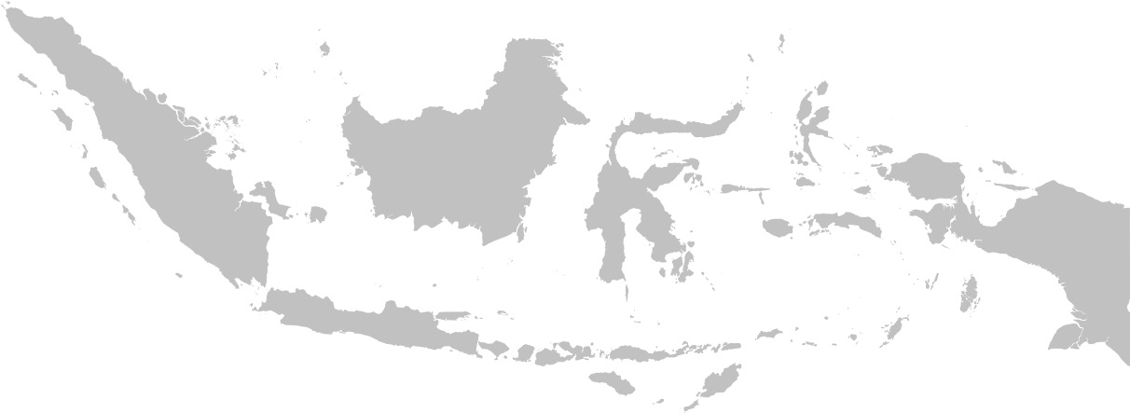
Anomaly Detection & Feature Importance of School Accreditation
William SUSANTO
GA – DSI_09

Slide 2
AGENDA
Context & Problem Statement
Dataset
Problem Solving
Result
Conclusion & Recommendation
Q & A

Slide 3
Context & Problem Statement

Slide 4
Context & Problem Statement
Context
“Quality education, shaping national identity” – anonymous
Problem Statement
To find high schools graded not according to the standard (anomaly detection)
To find determinant categories to improve high school accreditation (school grade)

Slide 5
Dataset

Slide 6


Dataset
High school accreditation score (2015 – 2018)
> 11.5k schools in 34 provinces (public & private)
129 features – 8 categories
(content, process, competency, educator, infrastructure, management, budget, evaluation)
Acc. Score = sum of all 129 features score (scaled)
(range: 0 – 100)
National exam score (year 2015 – 2018)
> 14.7k schools in 34 provinces (public & private)
Exam score range: 0 - 100

Slide 7
Problem Solving

Slide 8
Problem Solving
Step 1 - Data Cleaning
Blank cells, white spaces
Duplicate data points
Null values
Step 2 - Anomaly Detection
PCA
Anomaly detection – Isolation Forest
Anomaly feature importance – Random Forest
Step 3 – School grade determinant category
Kmeans
Introduce National Exam data to measure school quality
Linear Regression, Random Forest Regression

Slide 9
Result

Slide 10
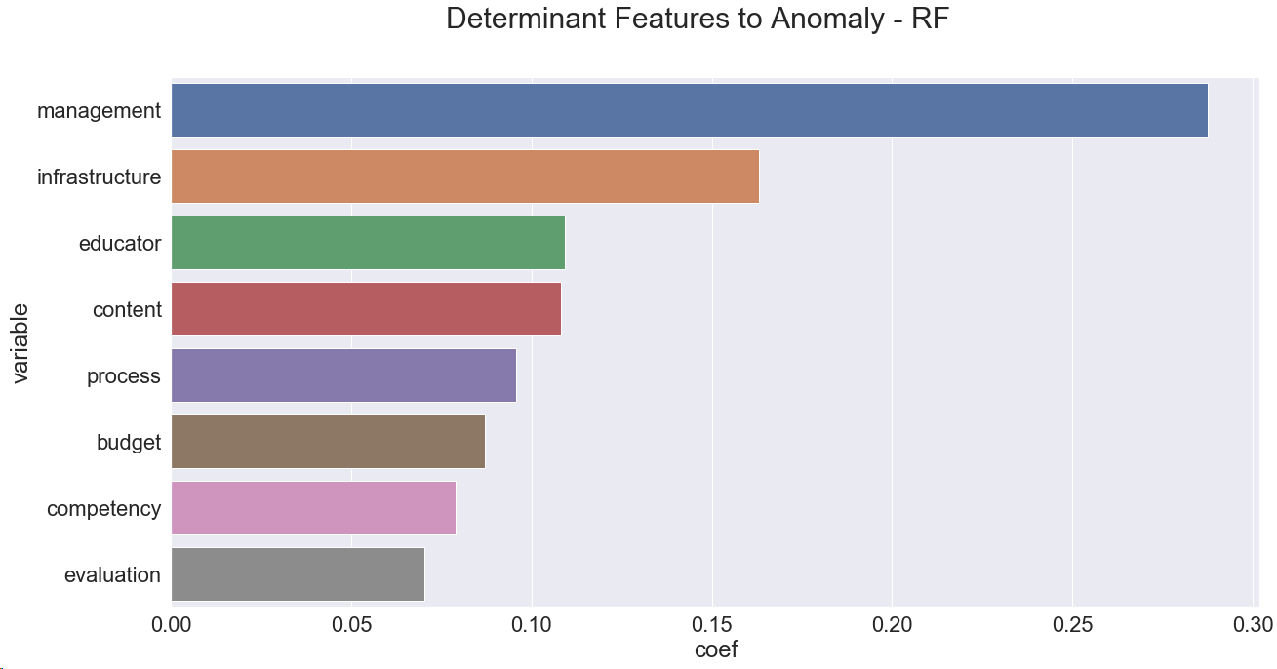
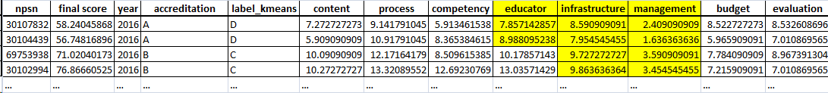
Result (Anomaly Detection)
Educator max score: 15
Infrastructure max score: 14
Management max score: 10

Slide 11
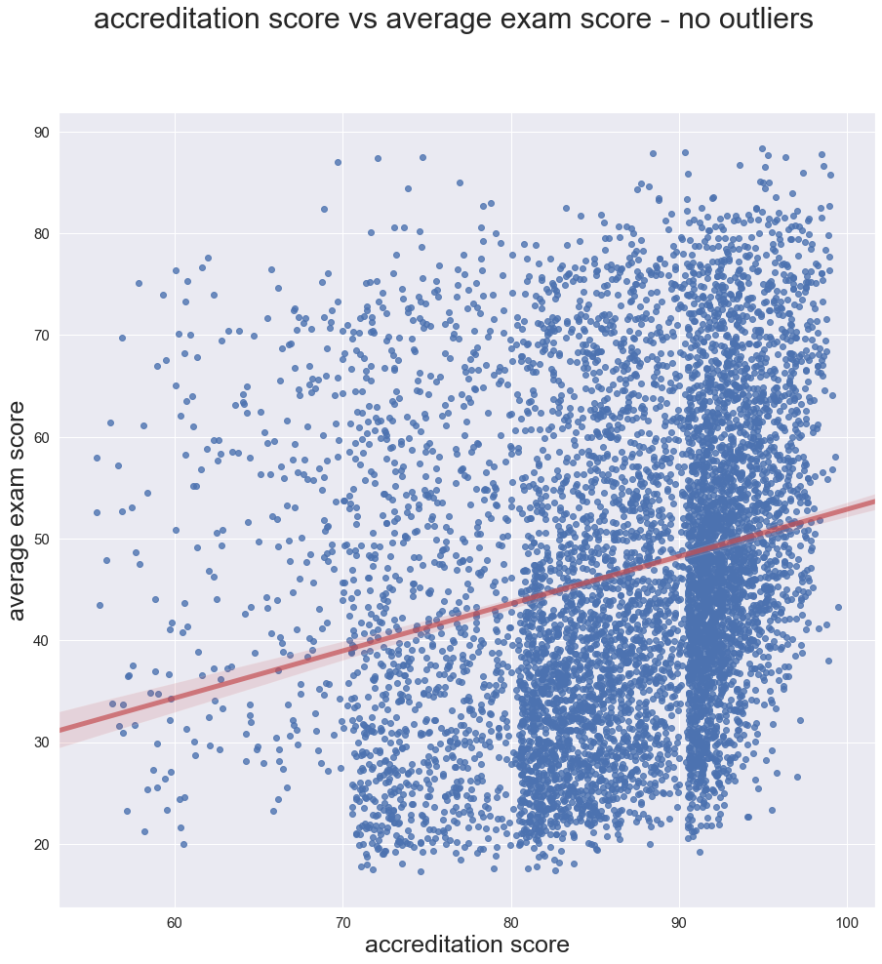
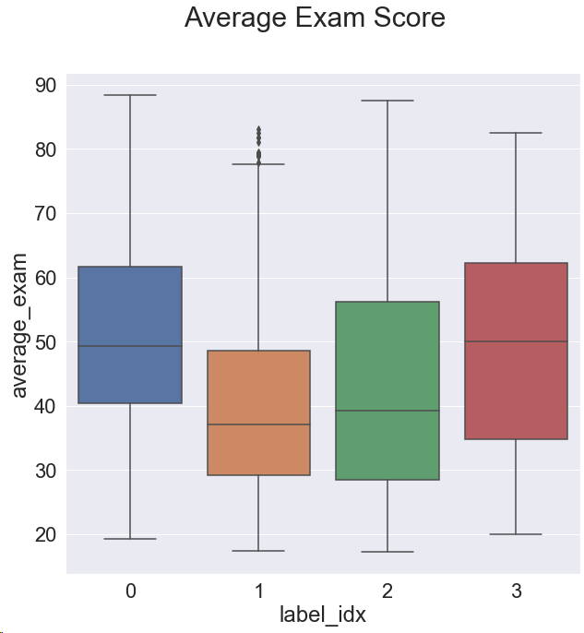
Result (School Grade)
Accreditation Score (School Grade) + Exam Score
A
B
C
D

Slide 12
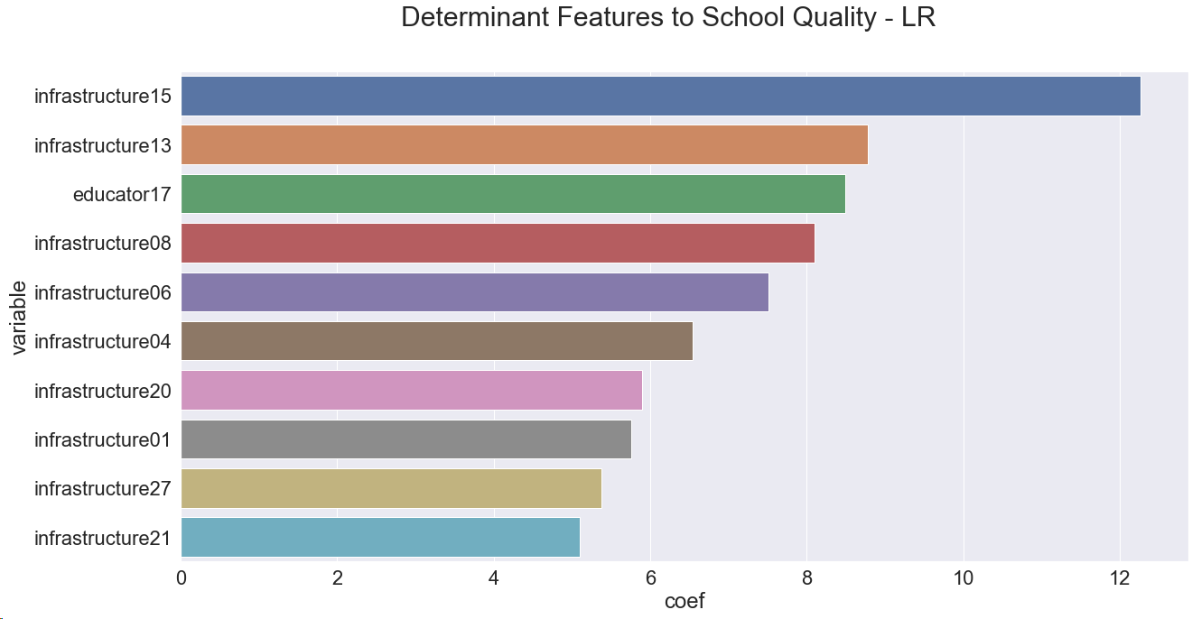
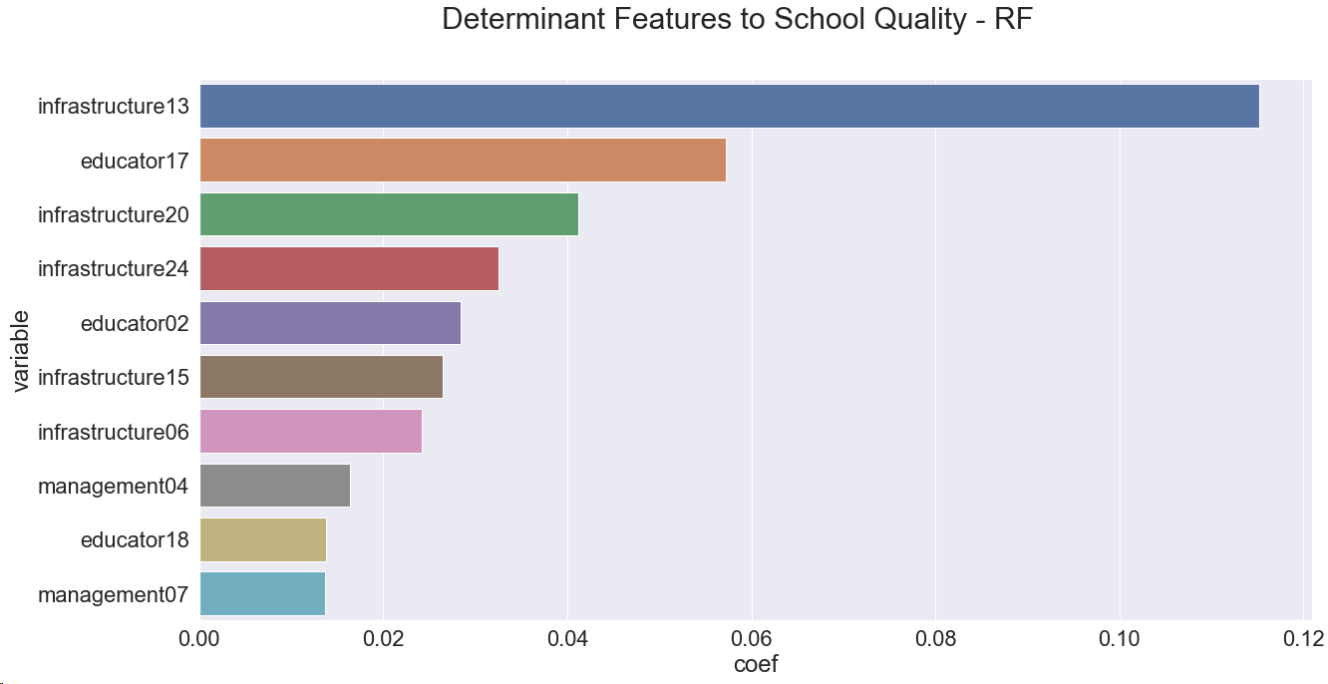
Result (School Grade)
High School Quality Determinant – Linear Regression
High School Quality Determinant – Random Forest

Slide 13
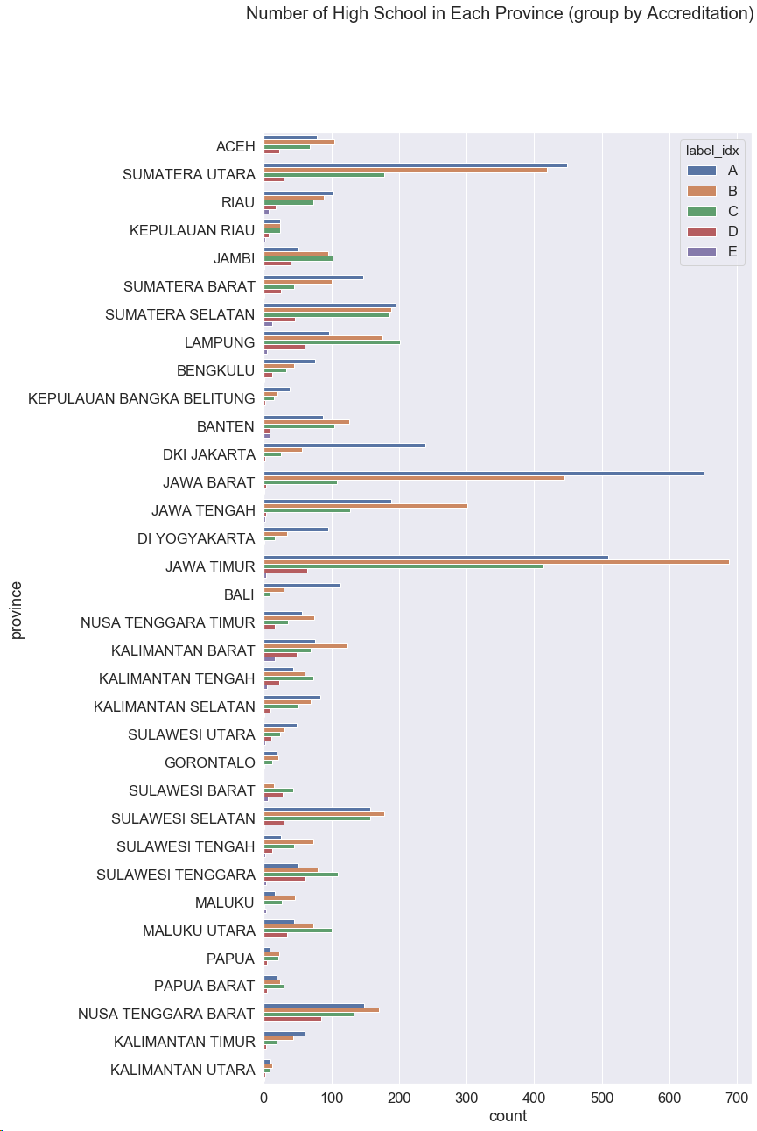
Result (School Grade)
Which Province should get more education attention?

Slide 14
Conclusion & Recommendation

Slide 15
Conclusion & Recommendation
Re-evaluate anomalous schools accreditation
Re-visit & audit the school without pre-notification.
Invent on infrastructure & educator categories:
Build laboratory, library…
Teacher wellness (salary), send teachers for training, higher degree courses.
Focus at three provinces: East Java, Lampung, & South Sumatera.

Slide 16
Q & A

